Slide 1
Gesture recognition using smart watch
--progress report
Steven Wang

Slide 2
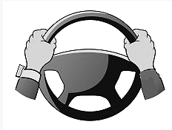
Project introduction
Allow a driver wearing a smart watch to use wrist and hand gestures to navigate through a watch app while keeping the watch bearing hand on the steering wheel.
Single / double outside rotation
Single / double inside rotation
Grip gesture

Slide 3
System flow chart
Raw data collection
Data processing
Data processing
Extract statistic features
Extract required features
Error analysis
Correlation analysis
Testing
Build classifier
Training

Slide 4
30 people raw data collection
Individual data collection
Data processing
Data processing
Data processing
Extract required features
Extract statistic features
Extract statistic features
Feed classifier
create classifier
Step 3: personal implement
Correlation analysis
Step 2: personal model training
Decide features
Select classifier
Explanation:
Step 1 is implemented on the laptop. We collect the raw data from 30 clients, clean and synchronize the data, extract the statistic features. We do the correlation analysis on each feature, to find out which one is significant to each gesture. Based on the features properties, we select a suitable classifier.
Step 2 is implemented on wearable device. The user will record the individual data into the wearable device. The device will do the data clean, data synchronize, and extract the significant feature based on step 1 result. Using these features and the classifier we select in step 1, the system will be trained.
Step 3 is implemented on wearable device as well. After the wearable system trained, the user’s gesture can be recognized by the wearable device.
Step 1: Generate model study

Slide 5
Explanation:
Step 1 is implemented on the laptop. We collect the raw data from 30 clients, clean and synchronize the data, extract the statistic features. We do the correlation analysis on each feature, to find out which one is significant each gesture. Based on the features curve distribution, we select a suitable classifier.
Step 2 is implemented on wearable device. The user will record the individual data into the wearable device, the device will do the data clean, data synchronize, and extract the significant feature based on step 1 result. Using these features and the classifier we select in step 1, the system will be trained.
Step 3 is implemented on wearable device as well. After the wearable system trained, the user’s gesture can be recognized by the wearable device.

Slide 6
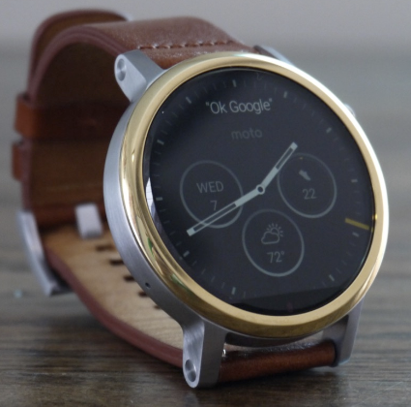
Data collection
Linear Accelerometer
The linear acceleration sensor provides a three dimensional vector representing acceleration along each device axis, excluding gravity
Gyroscope
The gyroscope measures the rate of rotation in rad/s (angular speed) around a device’s x, y, and z axis.
y
x
z

Slide 7
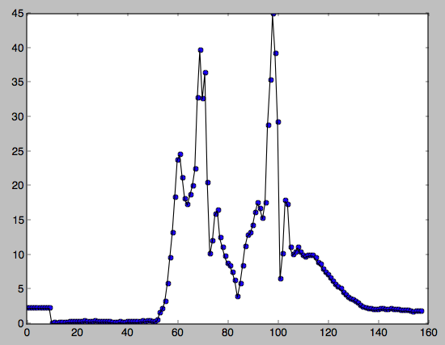
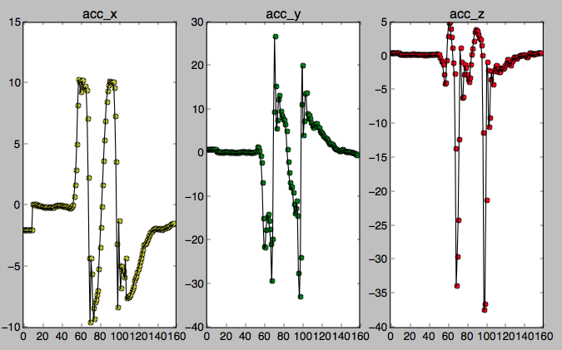
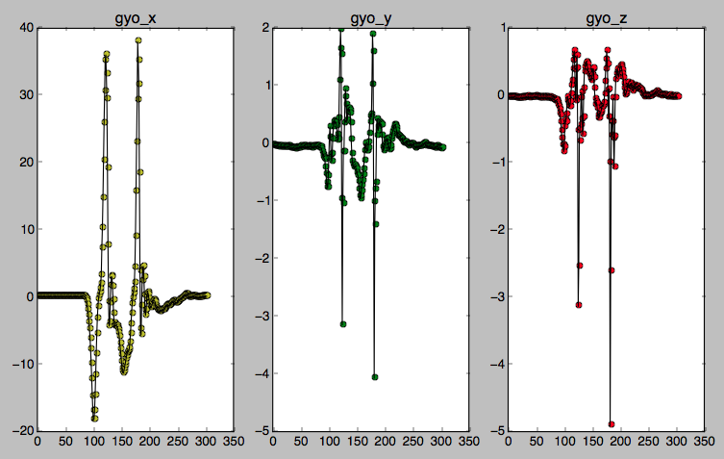
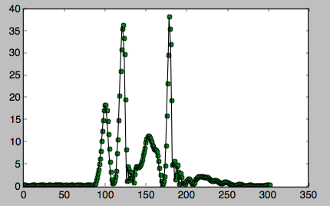
Data visualization – double inside
sqrt(acc_x² + acc_y ² + acc_z²)
acc magnitude
Sqrt(gro_x² + gro_y ² + gro_z²)
gro magnitude

Slide 8
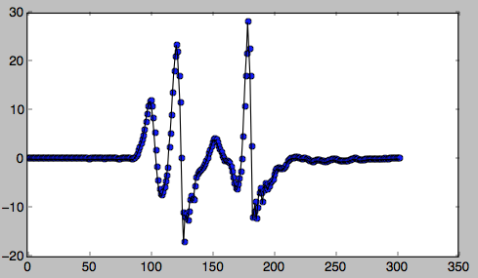
Relative angular speed
Define:
Set the angular speed magnitude at the first point as the speed reference value, label as as₀
Label the relative angular speed at n^{th} point as rAs_{n}. Label the angular speed magnitude at n^{th} point as as_{n}
rAs_{n} = as_{n} – as₀
Formula:
as_{last} = as_{current}
as_{current}= sqrt(gro_x² + gro_y ² + gro_z²)
delta = as_{current}- as_{last}
rAs_{n} = rAs_{n-1} * 0.9 + delta
Double inside gro_magnitude
Double inside rAs

Slide 9
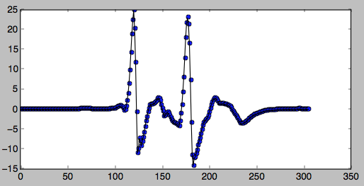
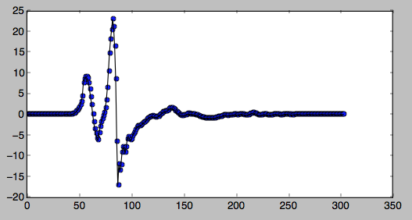
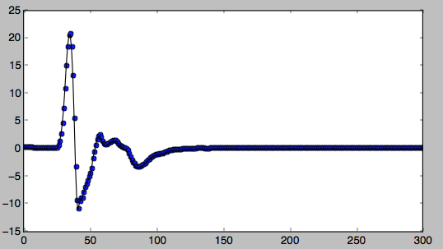
Plot of relative angle speed
double inside
double outside
single inside
single outside

Slide 10
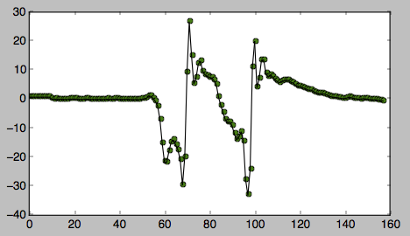
Event trigger and feature extraction
Relative angular speed
Algorithm:
rAs_{arr}=[] accY_{arr}=[] timer initial
trigger = false
if rAs>triggerThreshold and !trigger: trigger = true
timer start for 1 data chunk period:
rAs_{arr}.append(rAs) accY_{arr}.append(accY) timer reset
trigger = false
Trigger threshold
Data chunk period
acc_y
Time sync with rAs

Slide 11
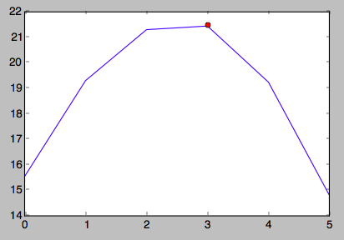
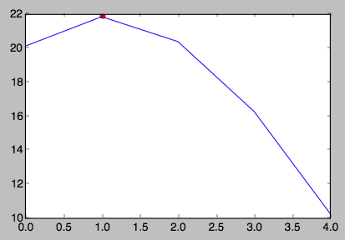
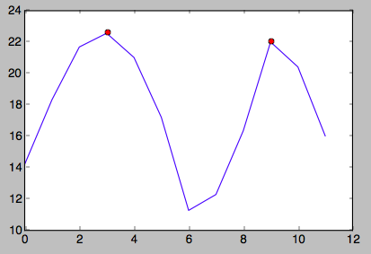
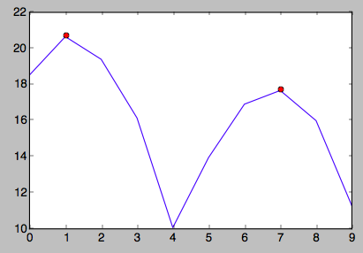
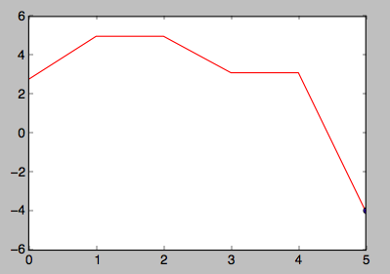
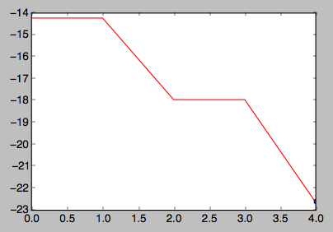
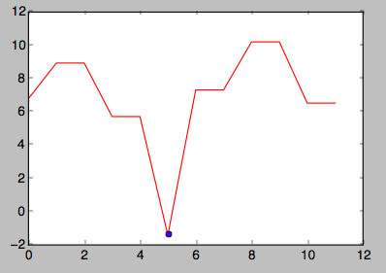
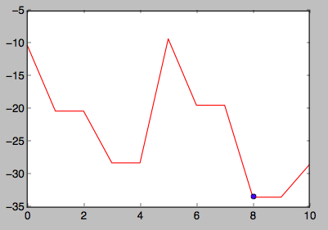
Feature extraction
peak_{arr}=[]
for i in range1,len(rAs_{arr}): if rAs_{arr}[i]>rAs_{arr}[i-1] and rAs_{arr}[i]>rAs_{arr}[i+1]: peak_{arr}.append(rAs_{arr}[i])
Feature 1: # of peak_{arr} = len(peak_{arr})
rAs_{arr}
single outside
single inside
accY_{arr}
double outside
double inside
single outside
single inside
Feature 2: min_accY = min(accY_{arr})
double outside
Double inside

Slide 12
Classification
Decision tree
Value = [so,si,do,di]
# of peak_{arr}>=peakThresh
True
False
min_accY<accY thresh
Value = [0,0,1,1]
min_accY<accY thresh
Value = [1,1,0,0]
True
False
True
False
Value = [0,0,0,1]
Value = [0,0,1,0]
Value = [0,1,0,0]
Value = [1,0,0,0]

Slide 13
Validation
Trigger threshold = 10
Data period = 1s
peakThresh = 2
accY thresh = -15
Single Outside | Single Inside | Double Outside | Double Inside
so | si | do | di
so | si | do | di
so | si | do | di
so | si | do | di
so | si | do | di
so | si | do | di
so | si | do | di
so | si | do | di
so | si | do | di
so | si | do | di
so | si | do | di
100% | 100% | 100% | 100%
Single Outside | Single Inside | Double Outside | Double Inside
SO | SI | SO | DI
SO | SI | SO | SI
SO | SI | DO | DI
SO | SI | SO | DI
SO | SI | SO | SI
SO | SI | SO | DI
SO | SI | SO | DI
SO | SI | SO | DI
SO | SI | DO | DI
SO | SI | SO | DI
SO | SI | SO | DI
100% | 100% | 20% | 80%
free hand
Holding steering wheel

Slide 14
Validation
Trigger threshold = 6
Data period = 1s
peakThresh = 2
accY thresh = -15
Single Outside | Single Inside | Double Outside | Double Inside
SO | SI | DO | DI
SO | SI | DO | DI
SO | SI | DO | DI
SO | SI | DO | DI
SO | SI | DO | DI
SO | SI | DI | DI
SO | SI | DO | DI
SO | SI | DO | DI
SO | SI | DO | DI
SO | SI | DO | DI
SO | SI | DO | DI
100% | 100% | 90% | 100%
Single Outside | Single Inside | Double Outside | Double Inside | Single Inside
SO | SI | DO | DI | SI
SO | SO | DO | DI | SI
SO | SI | DO | DI | SI
SO | SI | DI | DI | SI
SO | SI | DO | DI | SO
SO | SO | DO | DI | SI
SO | SO | DO | DI | SI
SO | SI | DO | DI | SI
SO | SI | DO | DI | SI
SO | SI | DO | DI | SI
SO | SI | DO | DI | SI
100% | 70% | 90% | 100% | 90%
free hand
Holding steering wheel

Slide 15
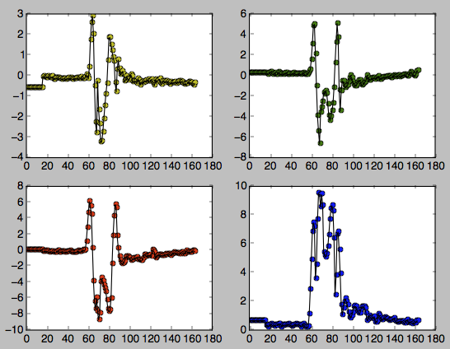
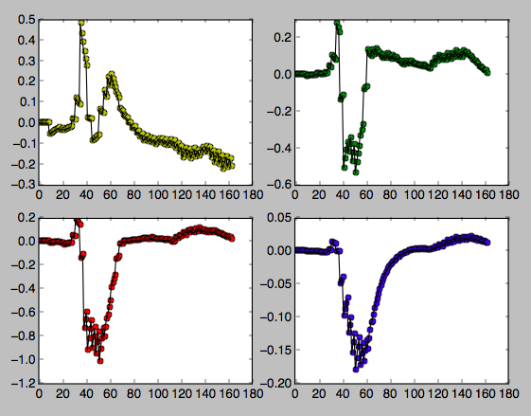
Grip gesture
Issues:
Watch tightness and position variability has a significant effect on the sensor results
High order integrate of sensor value decrease the sensor accuracy dramatically.

Slide 16
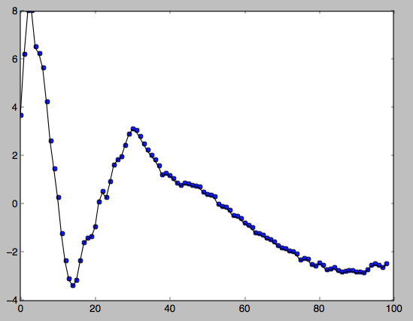
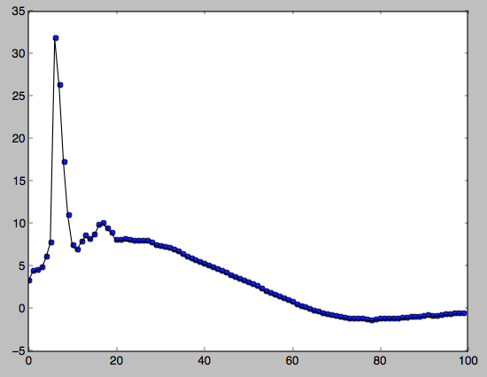
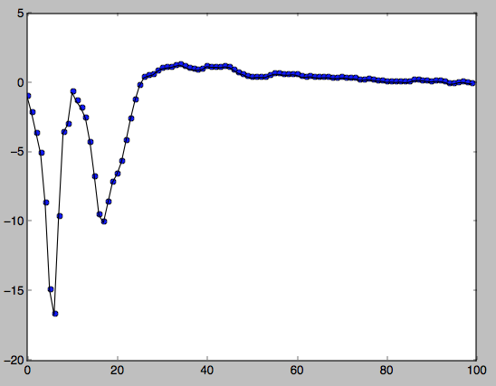
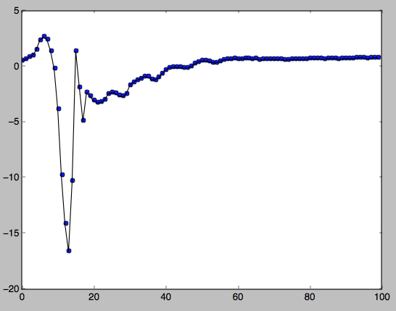
ACC_Z

Slide 17
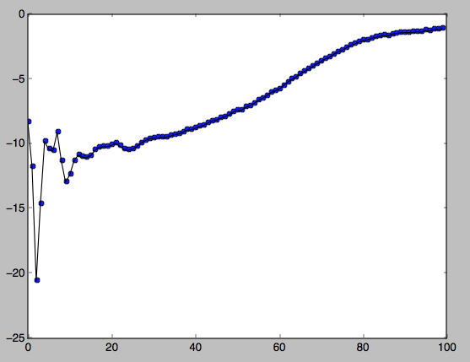
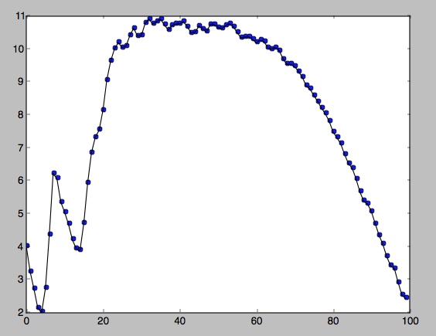
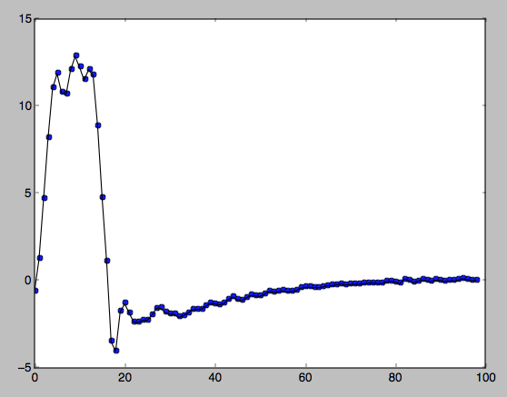
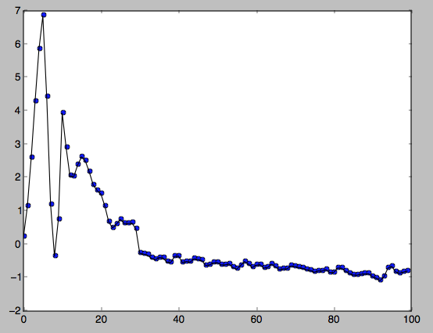
ACC_x

Slide 18
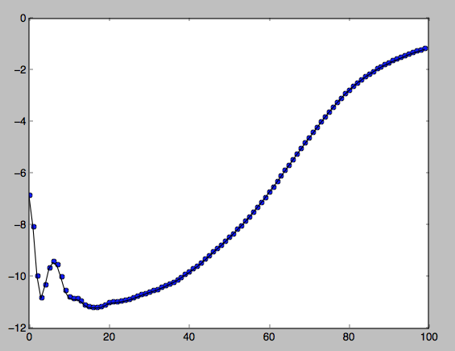
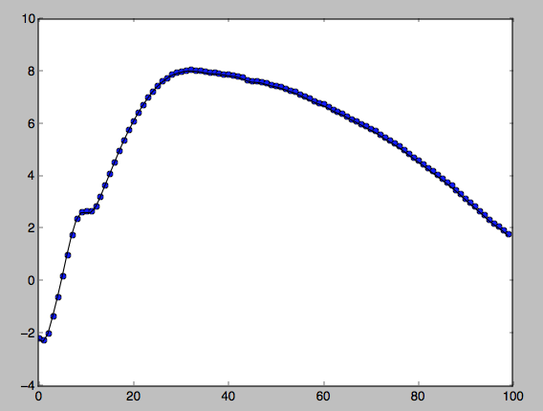
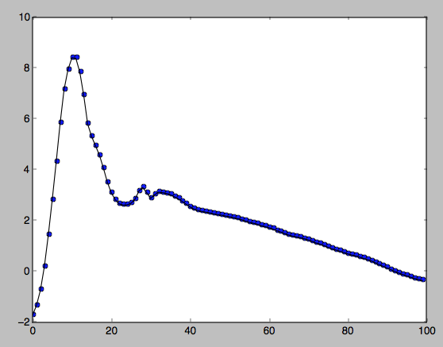
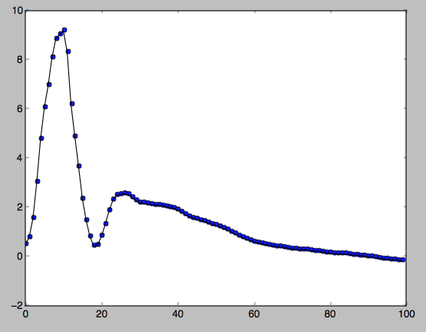
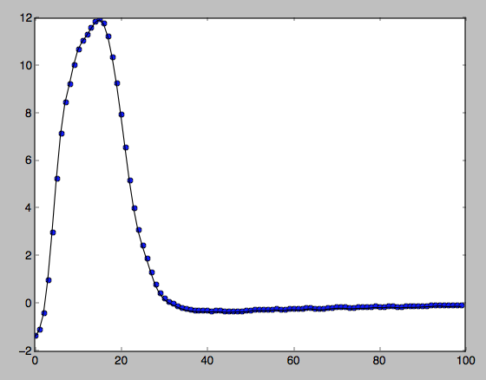
Acc_x_lowpass filter
leaving
back
Slight rotation
Strong rotation
rotation

Slide 19
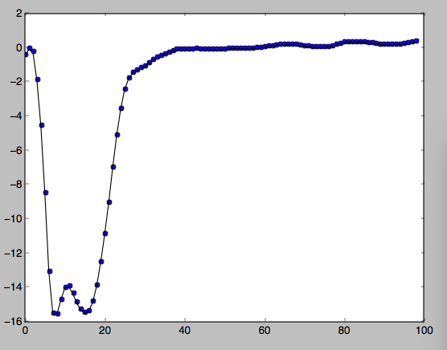
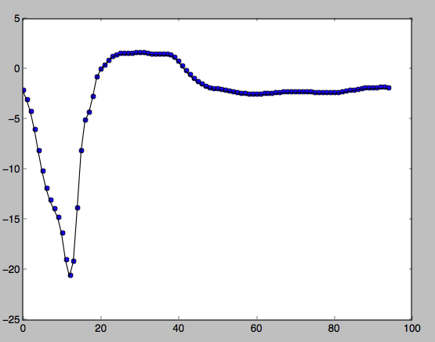
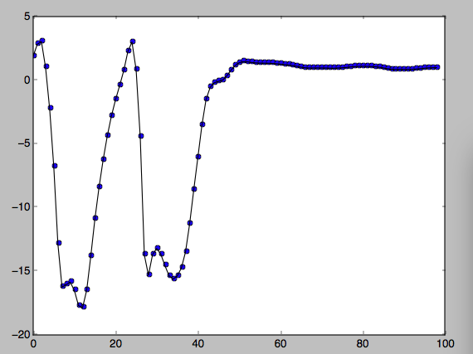
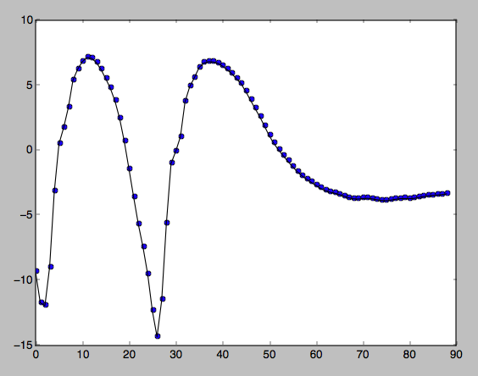
Gesture acc_y
Single_outside
Single_inside
Double_outside
Double_inside

Slide 20
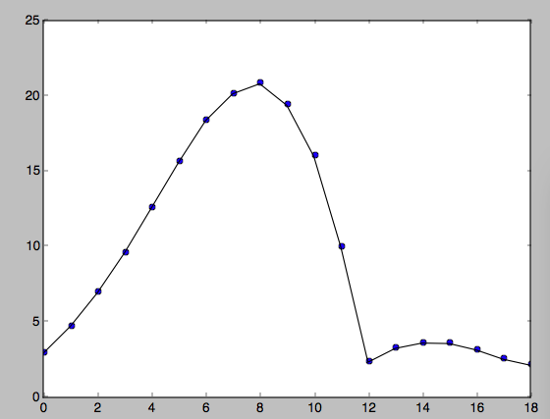
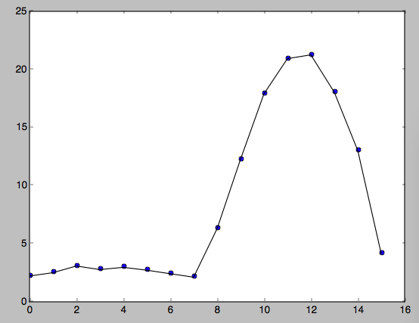
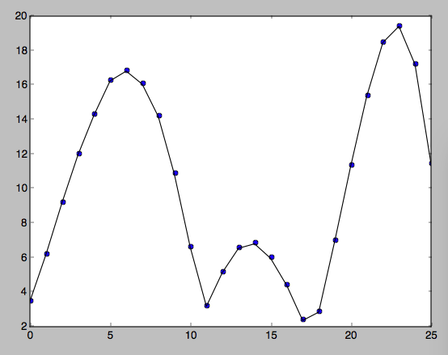
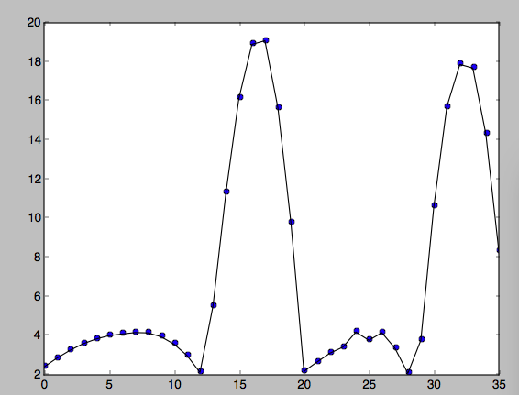
Gesture mGry
Single_outside
Single_inside
Double_outside
Double_inside

Slide 21
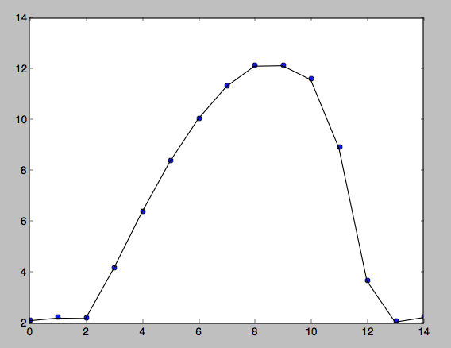
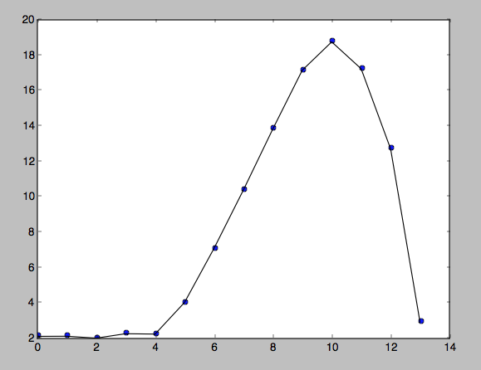
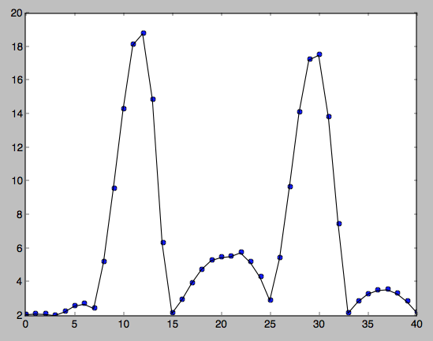
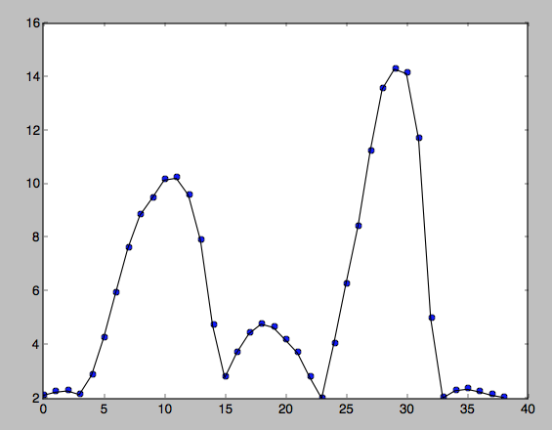
Holding Gesture mGry
Single outside holding
Double outside holding
Double inside holding

Slide 22
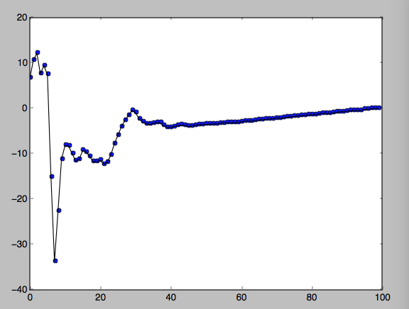
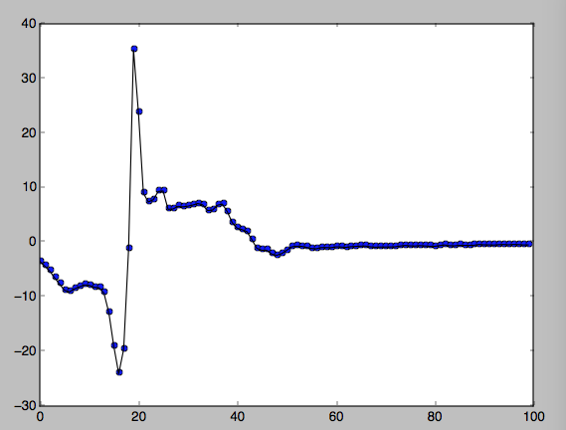
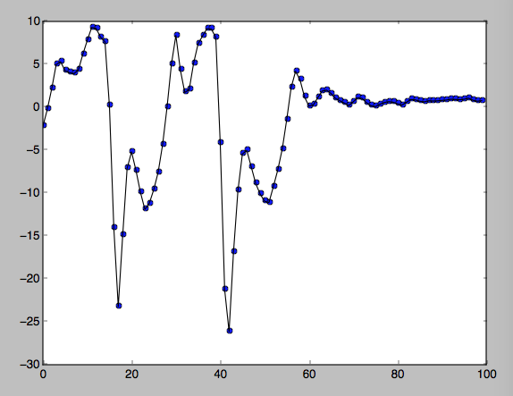
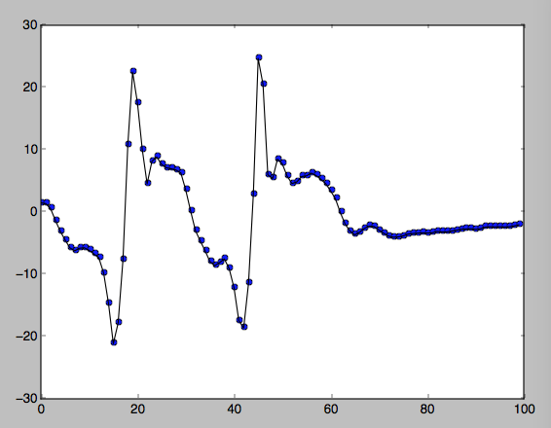
Holding gesture accy without filter
Single outside
Single inside
Double outside
Double inside

Slide 23




Holding gesture accy with filter
Single outside
Single inside
Double outside
Double inside

